Slide 1
Theory of Automata
Memoona Malik

Slide 2
Outline
Computation
Computing Models
Algorithms
Theory of computation
Computability Theory
Complexity Theory
Automata Theory
Basics of Automata

Slide 3
Computation
Computation is any type of arithmetic or non-arithmetic calculation that follows a well-defined model.
Mechanical or electronic devices that perform computations are known as computers.
An especially well-known discipline of the study of computation is computer science.

Slide 4
Cont…
Computing is as old as human beings
In fact, the earliest known mathematical object is the
Lebombo bone
which dates back to 35,000 BC! After that humans also used clay
tablets which are found in many civilizations.

Slide 5
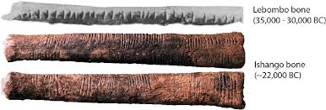
Cont…

Slide 6
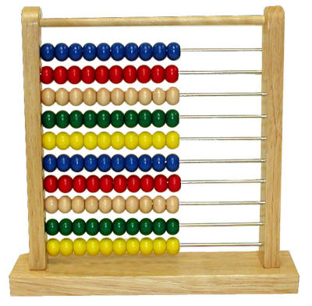
Cont…
Abacus was the next device. Here is a picture of a typical abacus.

Slide 7
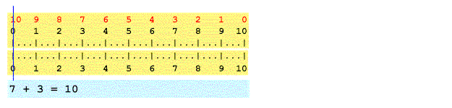
Cont…
Slide rule was another device that was invented in 1600’s.

Slide 8
Algorithm
When was the first algorithm devised?

Slide 9
Cont…
Perhaps, the first algorithm devised was unary addition thousands of years ago in some cave. The lebombo bone type devices were used to execute that algorithm.

Slide 10
Cont…
Arithmetic algorithms, such as a division algorithm, were used by ancient Babylonian mathematicians 2500 BC and Egyptian mathematicians c. 1550 BC.
Greek mathematicians later used algorithms in 240 BC for finding prime numbers, and the Euclidean algorithm for finding the greatest common divisor of two numbers.
Arabic mathematicians such as al-Kindi in the 9th century used cryptographic algorithms for code-breaking.

Slide 11
Cont…
The most important question in theory of computation is:
What is a computation? What is an algorithm?
When was this question asked?

Slide 12
Cont…
In 1900 David Hilbert and eminent mathematician was invited to give a lecture at the international congress of mathematicians. In his talk he posed 21 questions as a challenge to 20th century mathematicians. His problems spanned several areas from mathematical analysis, logic, foundation of set theory and geometry. However, one of the question the 10th problem was very thought-provoking.

Slide 13
Cont…
Given an equation with any number of unknown quantities and with rational integral numerical coefficients: To devise a process according to which it can be determined in a finite number of operations whether the equation is solvable in rational integers.
Note two important words:
Process and
in a finite number of operations
Hilbert was asking for an algorithm!!

Slide 14
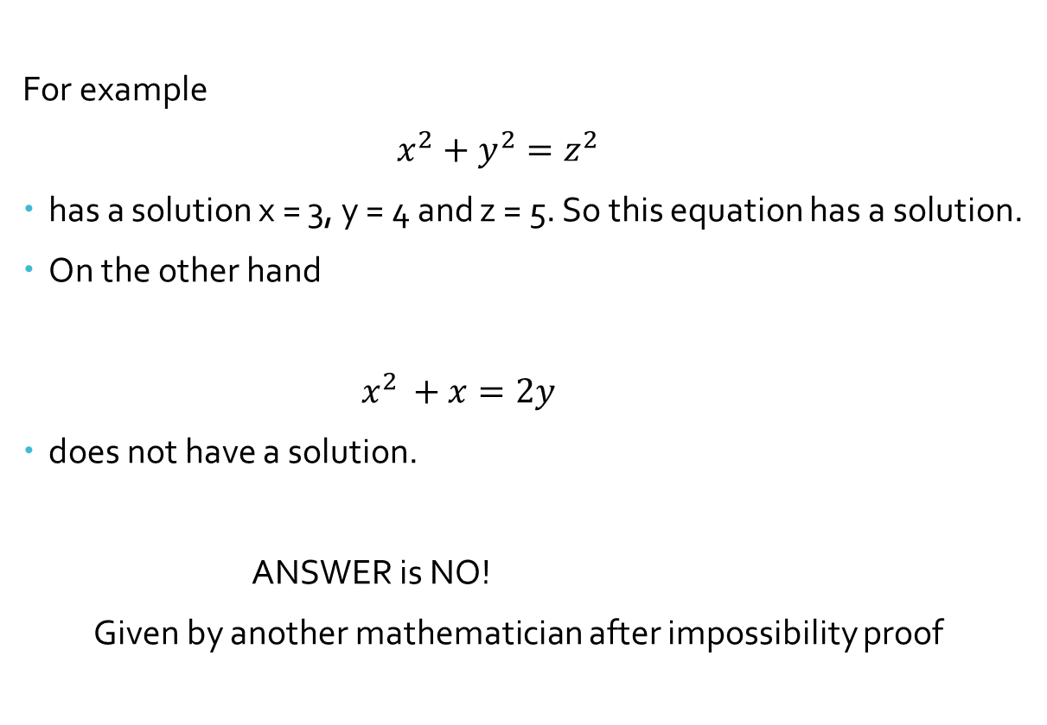
Cont…
For example
$x^{2}+y^{2}=z^{2}$
has a solution x = 3, y = 4 and z = 5. So this equation has a solution.
On the other hand
$x^{2 }+x=2y$
does not have a solution.
ANSWER is NO!
Given by another mathematician after impossibility proof

Slide 15
Impossibility Proof
In order to prove that algorithm cannot exist we must have a exact and mathematically precise definition of an algorithm. This is what is needed in order to show that an algorithm does not exist. Once a precise definition of an algorithm is given we can argue mathematically about them.

Slide 16

Cont…
It is impossible to write $\sqrt{2}$ as a ratio of two integers.
Or
$\sqrt{2}$ is a rational number

Slide 17
Cont…
In 1936, Alan Turing, Alonzo Church showed that the Entscheidungsproblem was unsolvable.
Turing came up with the idea of computing machines that we now call Turing machines.
A Turing machine is a mathematical model of computation describing an abstract machine . It is capable of implementing any computer algorithm.
Thus, an algorithm can be considered to be any sequence of operations that can be simulated by a Turing-complete system.

Slide 18
Cont…
Turing in the same paper showed that a very important problem called the “Halting Problem” cannot be solved by an algorithm.
This was a breakthrough. It showed that there are mathematically defined precise problems that have no algorithmic solutions. Thus showing us that some problems cannot be computed!!!!!!

Slide 19
Theory of computation
In theoretical computer science, the theory of computation is the branch that deals with what problems can be solved on a model of computation using an algorithm and how efficiently they can be solved.
The field is divided into three major branches:
automata theory and formal languages,
computability theory, and
computational complexity theory.

Slide 20
Computability Theory
Computability Theory will deal with the following questions:
What is a computation. Can we come up with a precise definition
of an algorithm or a computation? (The answer is yes).
Can everything be computed. (The answer is no.)
Can we characterize problems that cannot be computed. (The
answer is it is hard to do that but in certain cases we can identify
them and prove that they are not computable).

Slide 21
Complexity Theory
Complexity theory is much more practical than computability theory.
The basic idea is now we not only want an algorithm but an efficient algorithm to solve problems.

Slide 22
Cont…
Complexity Theory will deal with the following questions:
Given a problem can we devise an efficient algorithm to solve
that problem?
Can we characterize problems that have efficient algorithms?
Can we characterize problems that are on the boundary of being
efficiently solvable and intractable?
Can we prove that problems though computable are intractable?
Can we prove that certain problems which are practically
significant are intractable?

Slide 23
Automata Theory
Automata theory is the study of abstract machines and automata, as well as the computational problems that can be solved using them.
An automaton (automata in plural) is an abstract self-operating computing device which follows a predetermined sequence of operations automatically.

Slide 24
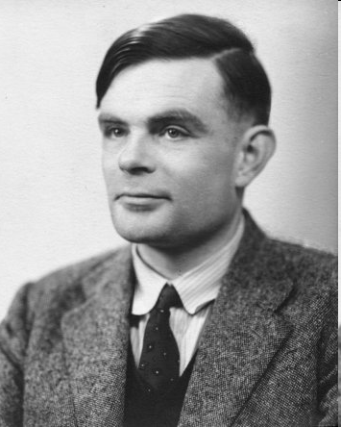
Alan Turing
Father of Modern Computer Science
English mathematician
Studied abstract machines called Turing machines even before computers existed
Proposed Turing test for intelligent machines

Slide 25
Theory of Computation: A Historical Perspective
Alan Turing studies Turing machines
Decidability
Halting problem
1930s
“Finite automata” machines studied
Noam Chomsky proposes the “Chomsky Hierarchy” for formal languages
1940-1950s
Cook introduces “intractable” problems or “NP-Hard” problems
1969
Modern computer science: compilers, computational & complexity theory evolve
1970-

Slide 26
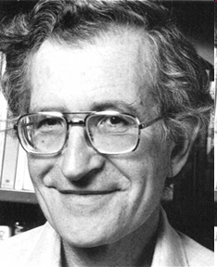
The Chomsky Hierarchy
A containment hierarchy of classes of formal languages
Recursively- enumerable (TM)
Context- sensitive (LBA)
Context- free
(PDA)
Regular
(DFA)

